Slide 2
Object Recognition -ANN/CNN (Cont…)

Slide 3
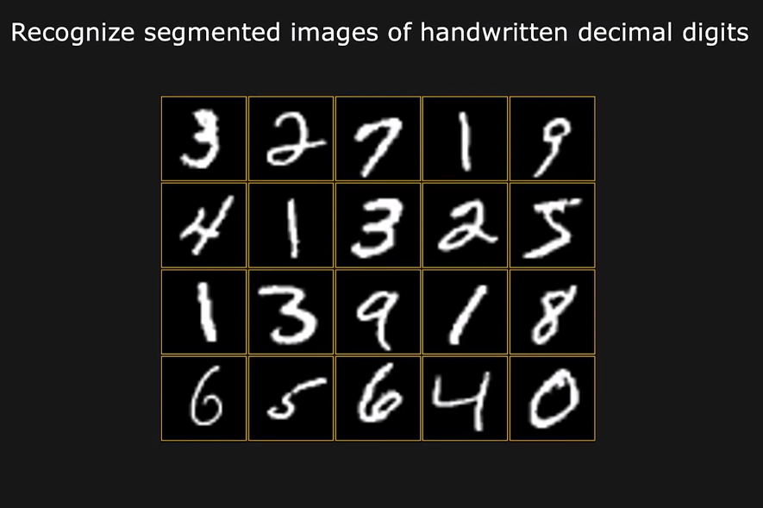
Recognizing Characters

Slide 4
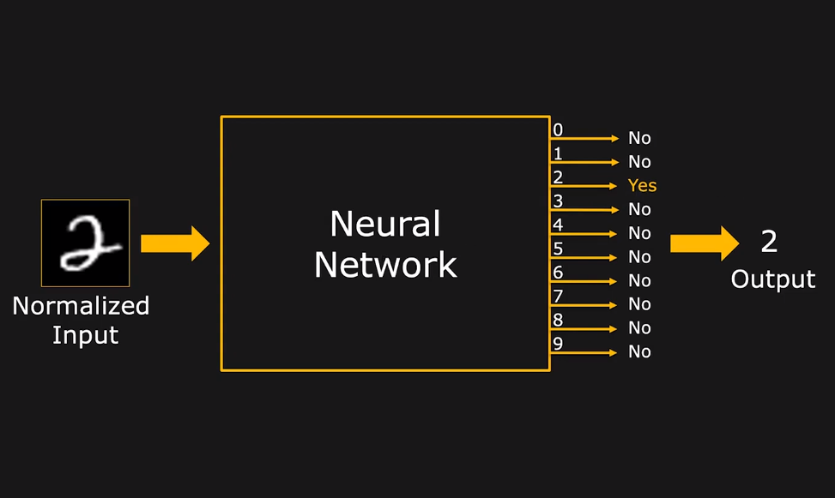
Recognizing Characters

Slide 5
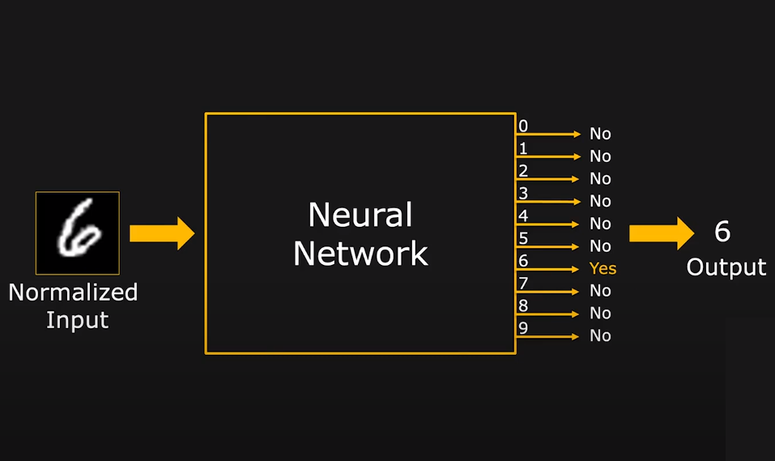
Recognizing Characters

Slide 6
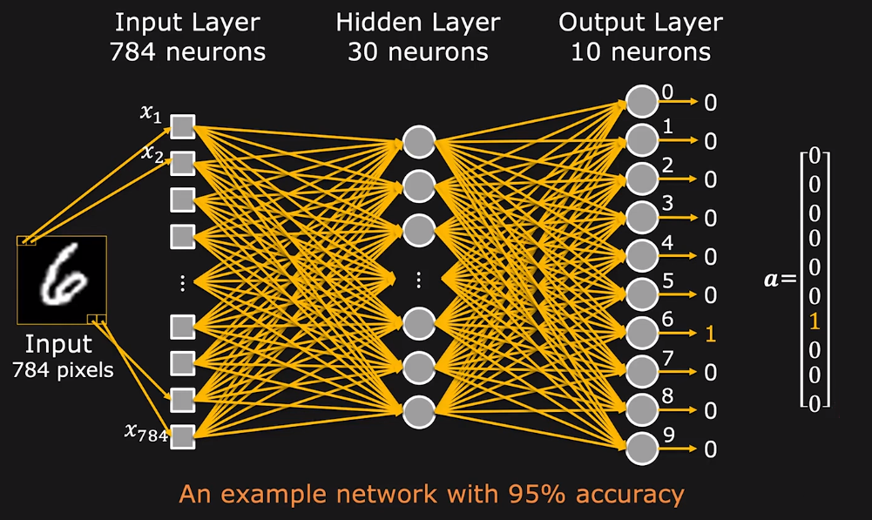
Character Recognition Network

Slide 7
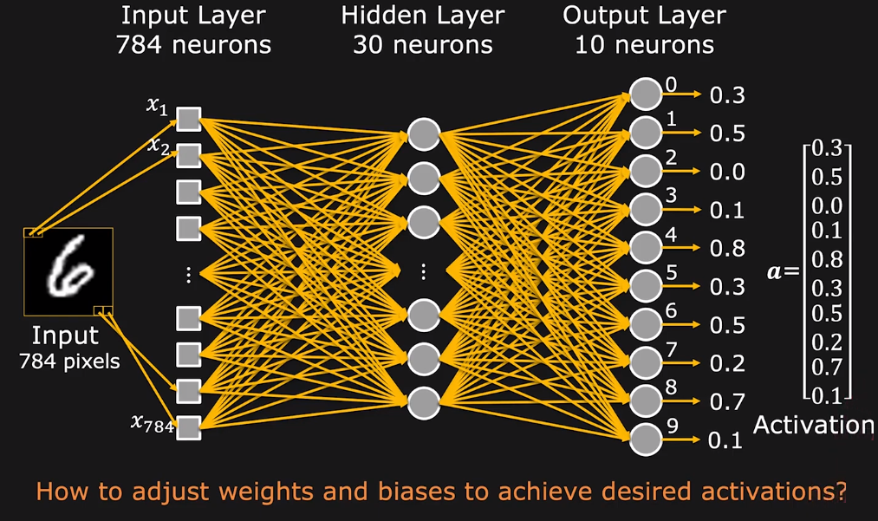
Network with Random Weights and Biases

Slide 8
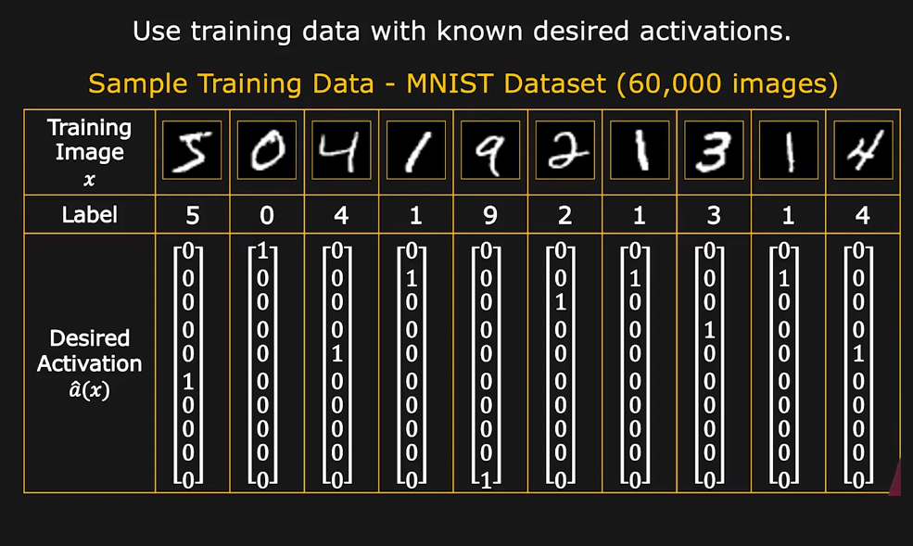
Training Data

Slide 9
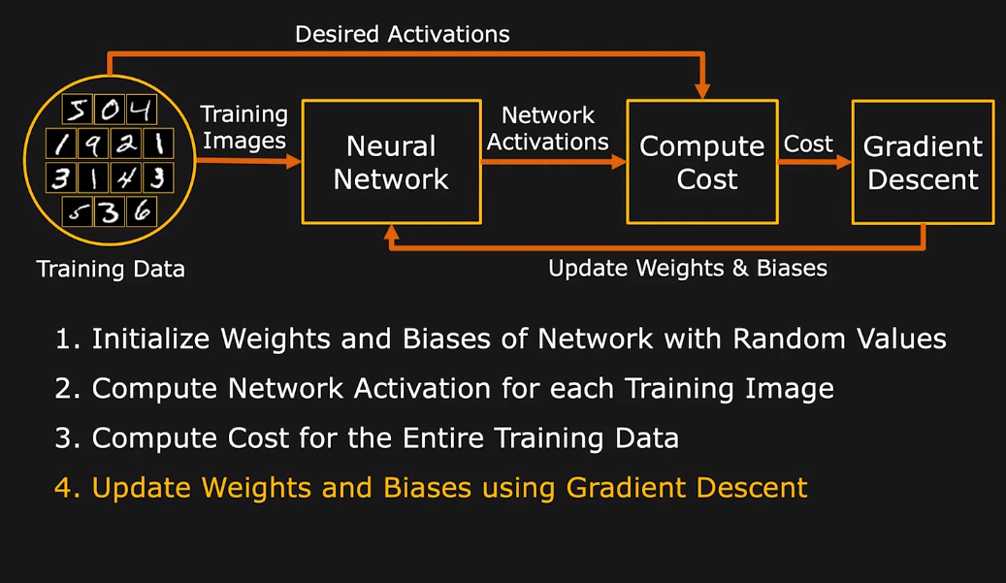
Training Process

Slide 10
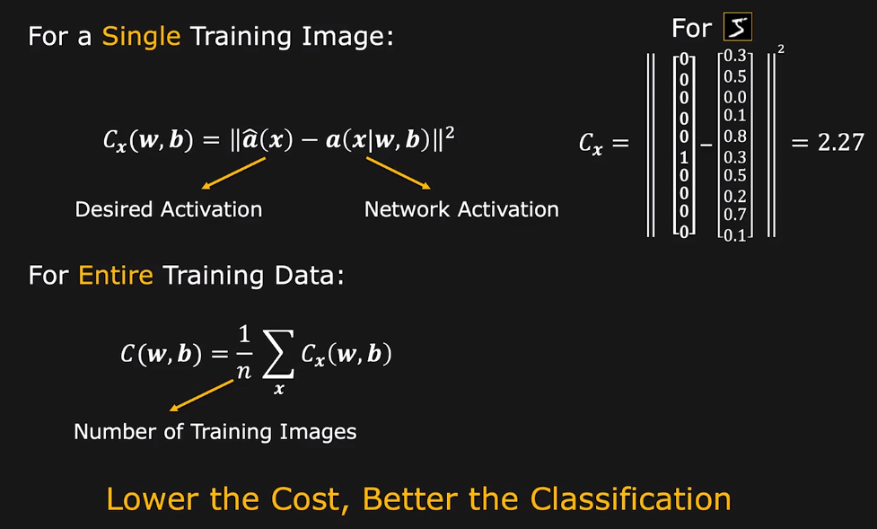
Computing Cost

Slide 11
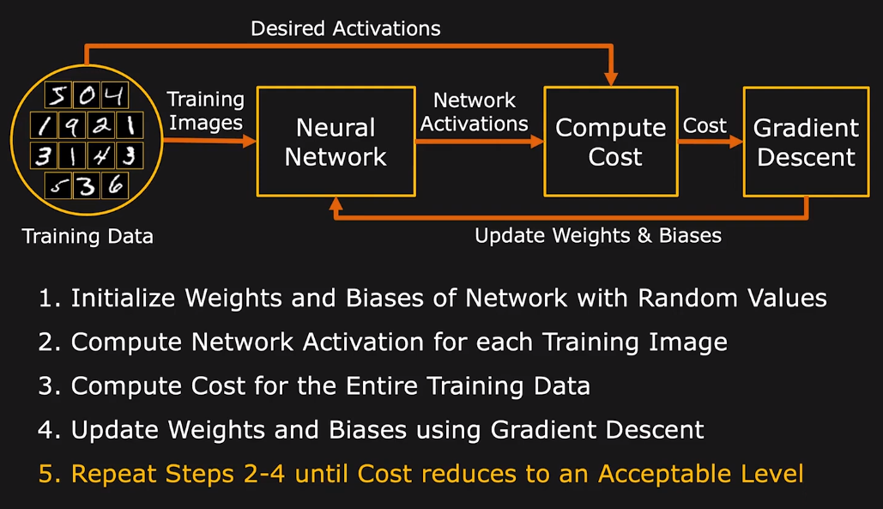
Training Process

Slide 12
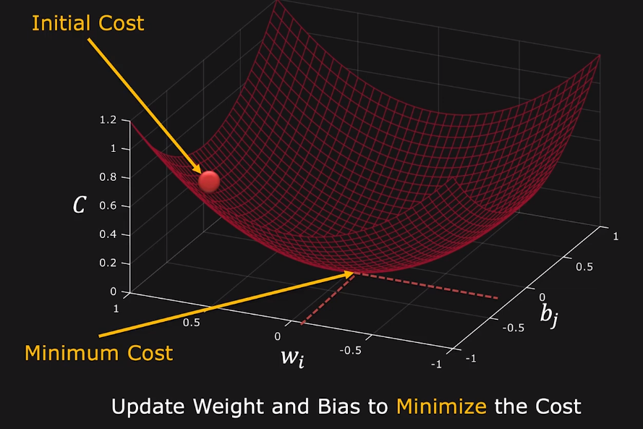
Updating Weights and Biases

Slide 13
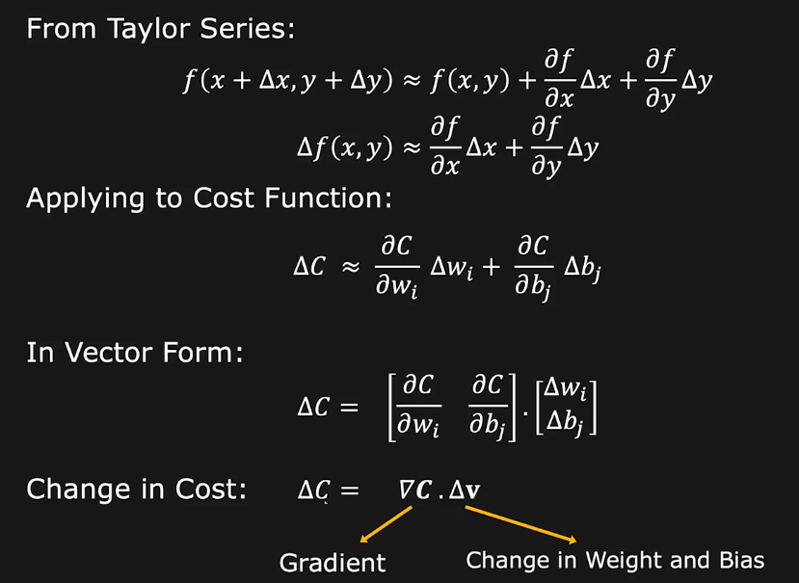
Change in Cost

Slide 14
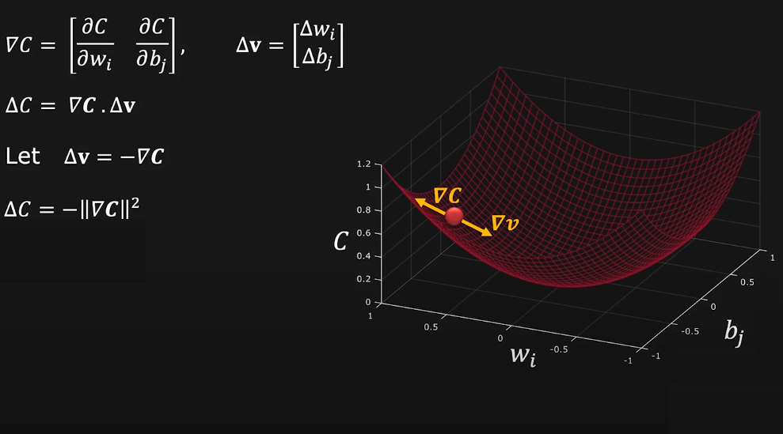
Gradient Descent

Slide 15
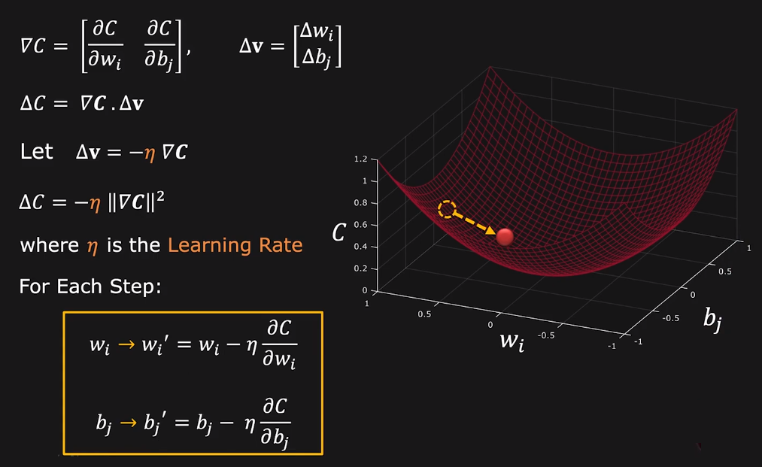
Gradient Descent

Slide 16
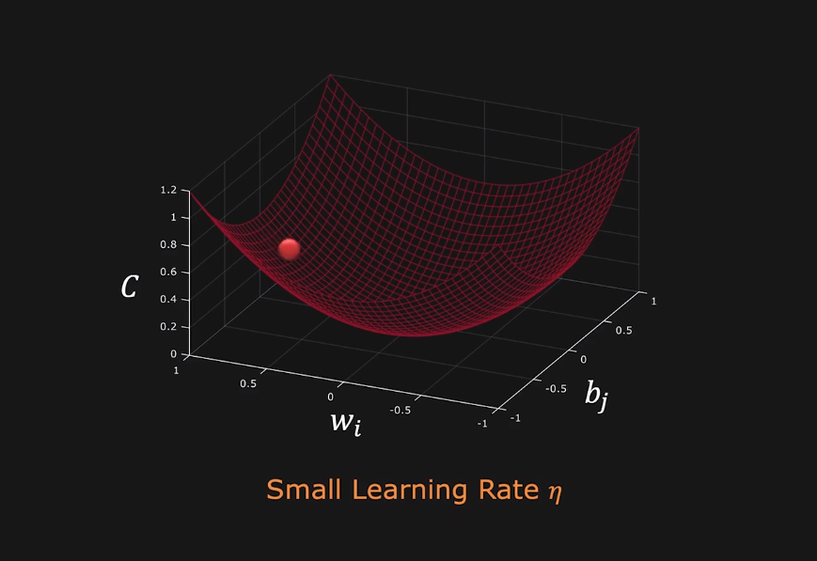
Effect of Learning Rate

Slide 17
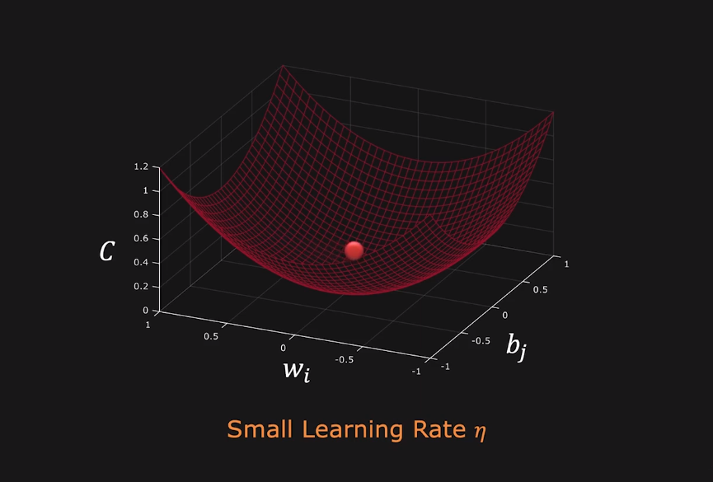
Effect of Learning Rate

Slide 18
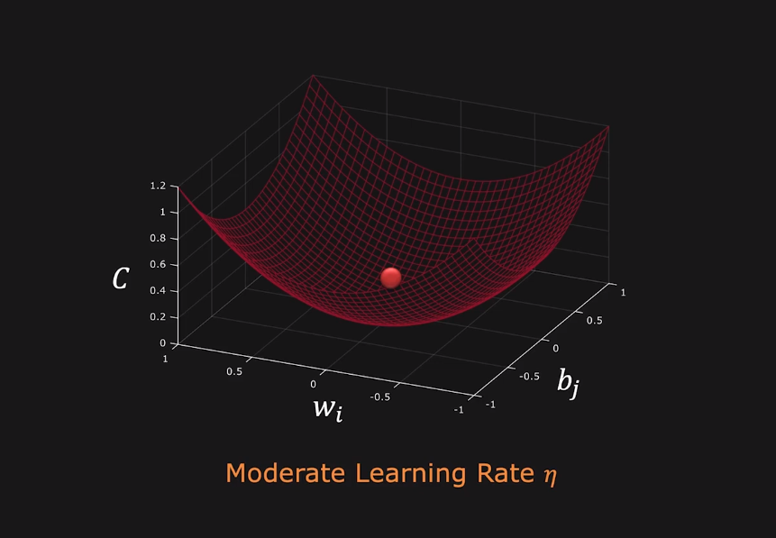
Effect of Learning Rate

Slide 19
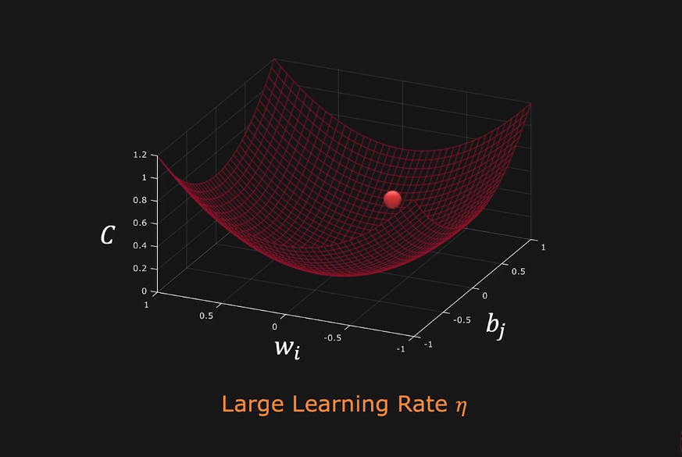
Effect of Learning Rate

Slide 20
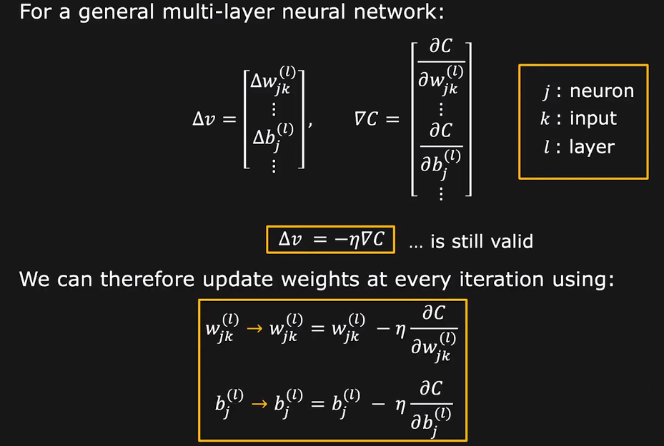
Gradient Descent for the Entire Network

Slide 21
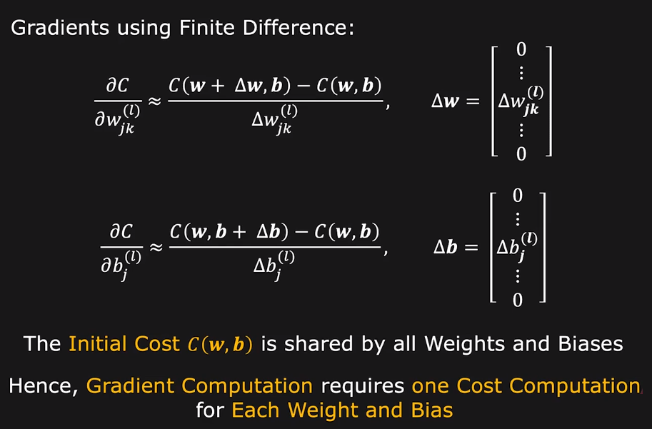
Gradient Computation

Slide 22
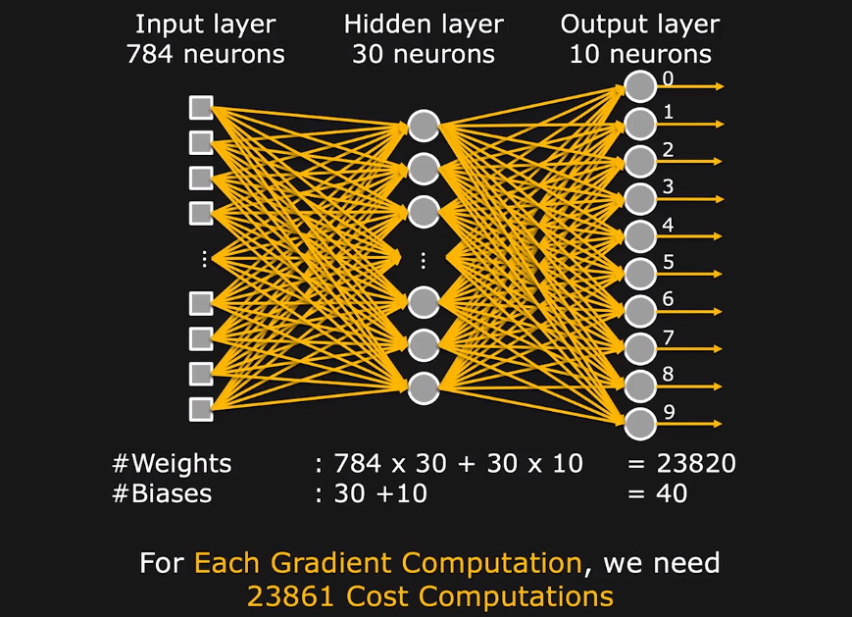
Gradient Computation Complexity

Slide 23
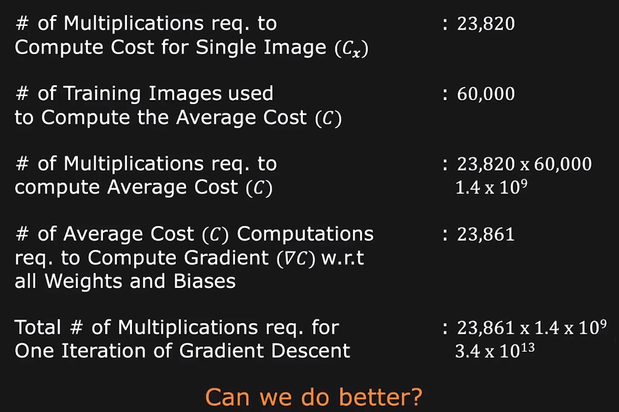
Gradient Computation Complexity

Slide 24
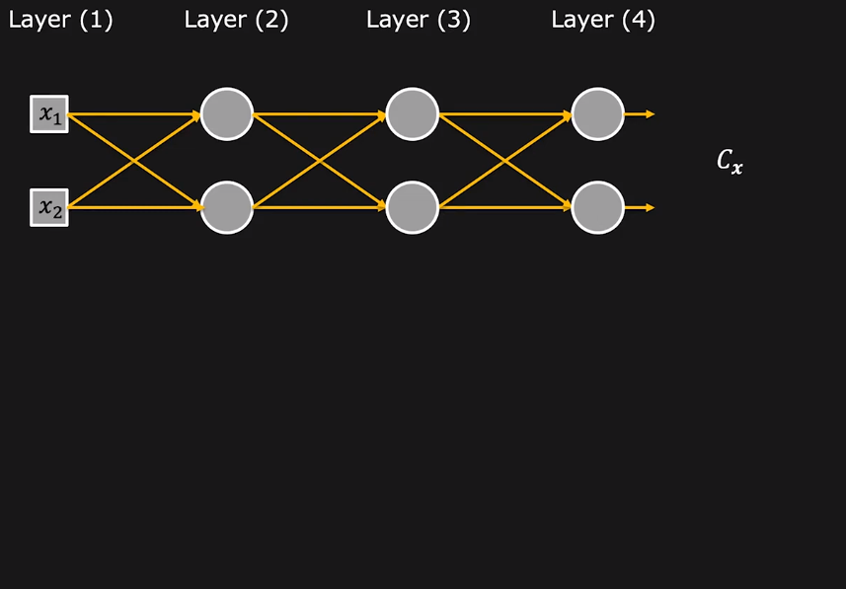
Computing Gradient using Chain Rule

Slide 25
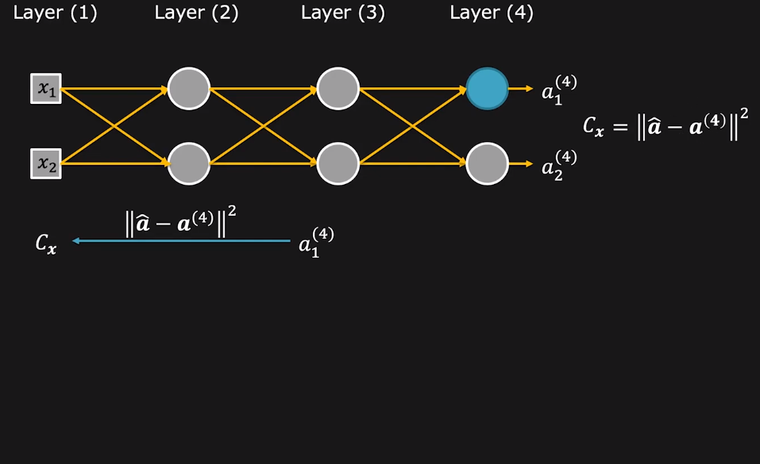
Computing Gradient using Chain Rule

Slide 26
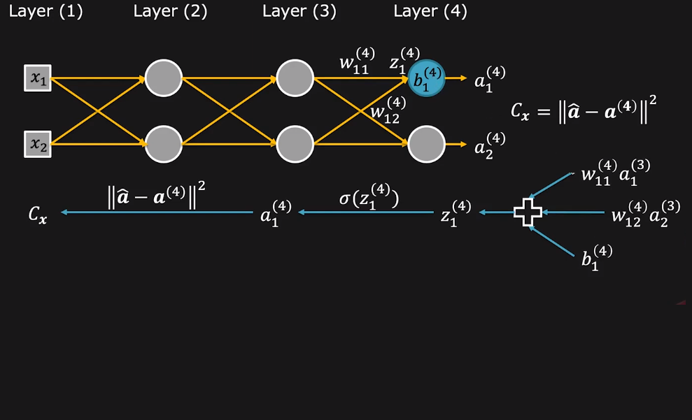
Computing Gradient using Chain Rule

Slide 27
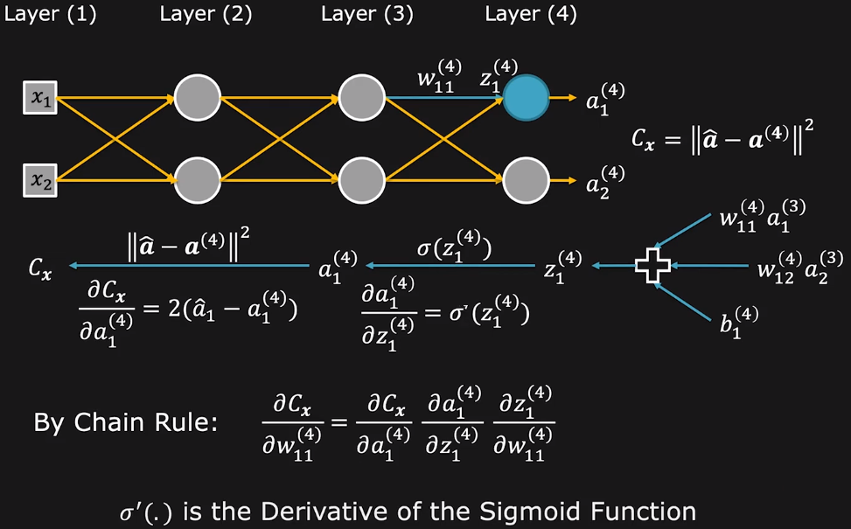
Computing Gradient using Chain Rule

Slide 28
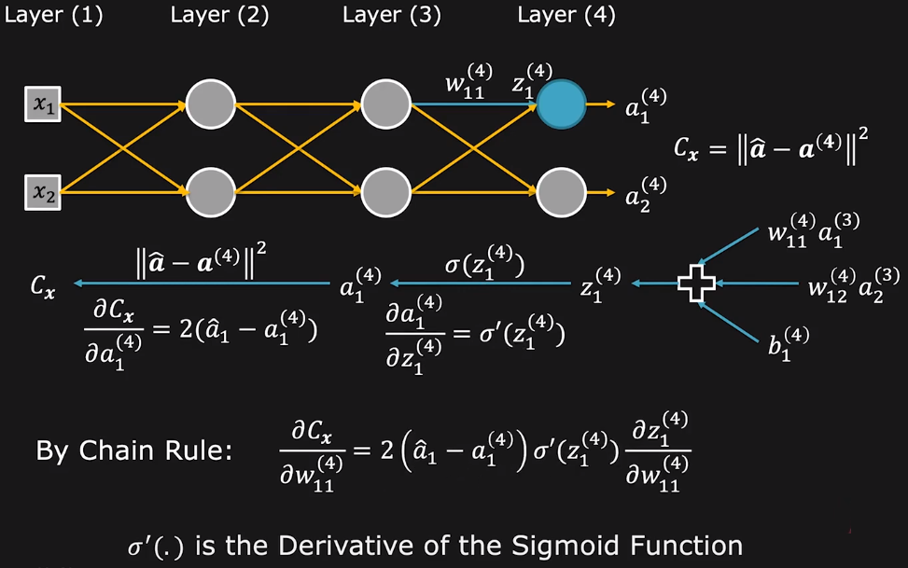
Computing Gradient using Chain Rule

Slide 29
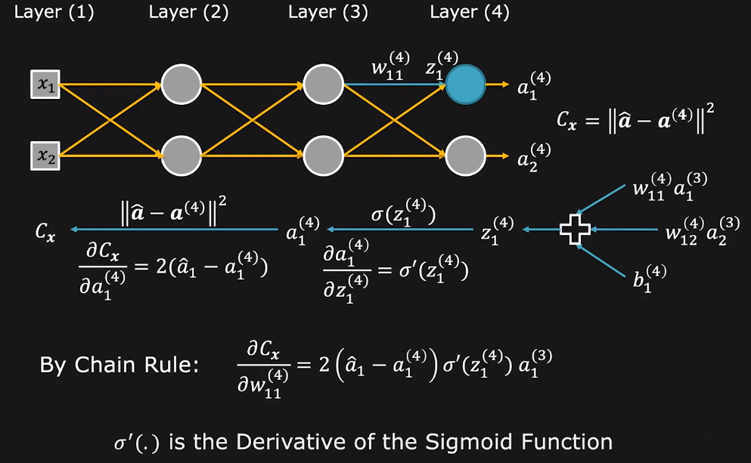
Computing Gradient using Chain Rule

Slide 30
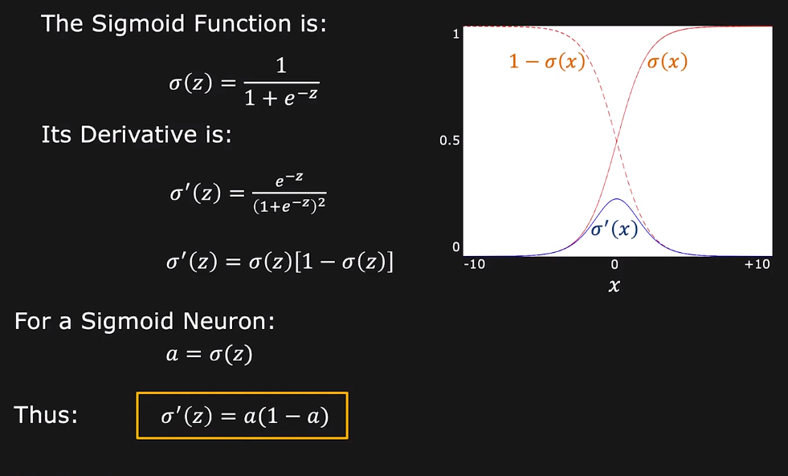
Derivative of Sigmoid Function

Slide 31
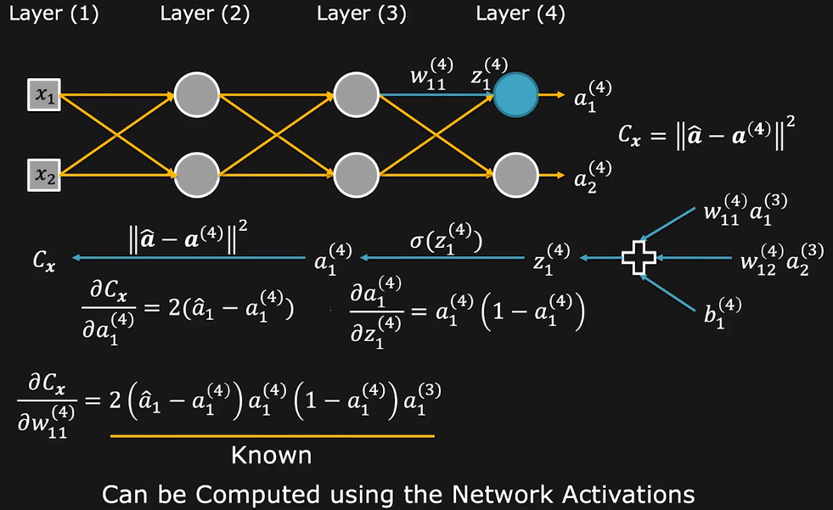
Computing Gradient using Chain Rule

Slide 32
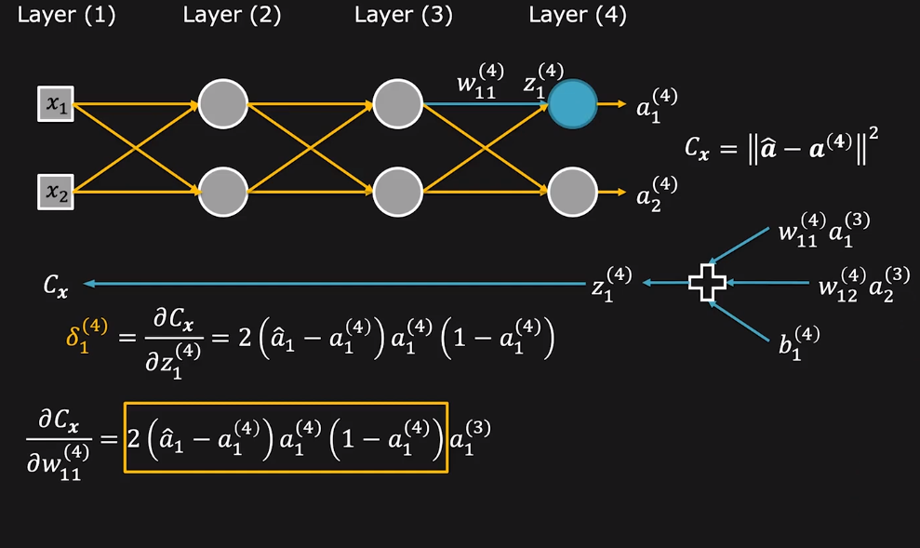
Computing Gradient using Chain Rule

Slide 33
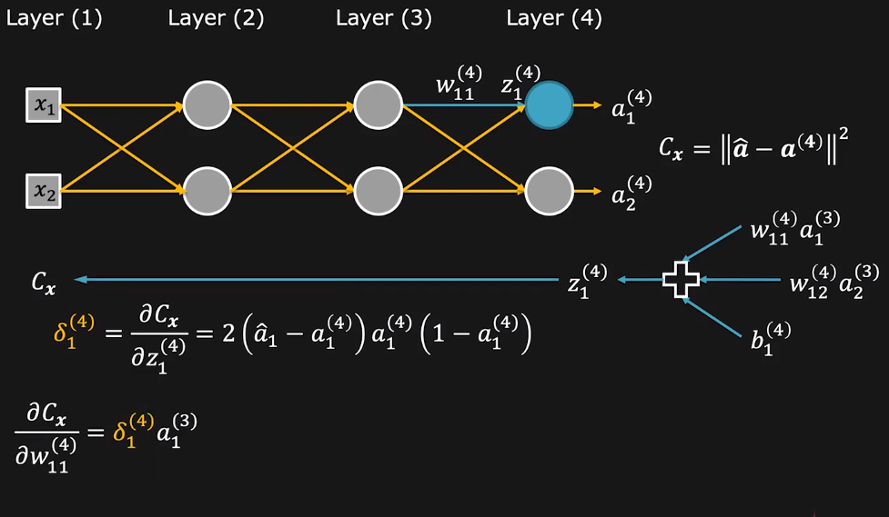
Computing Gradient using Chain Rule

Slide 34
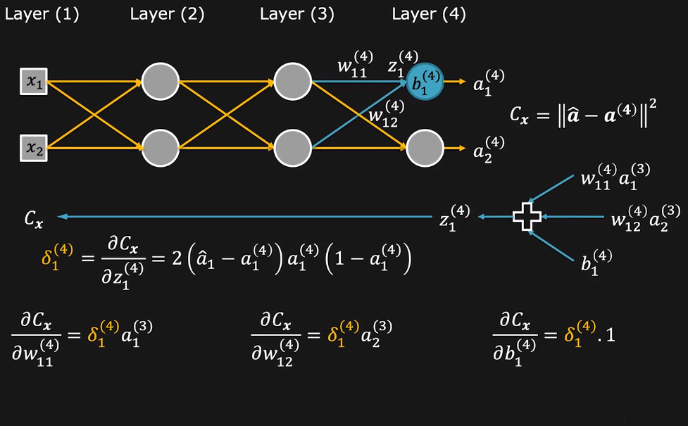
Computing Gradient using Chain Rule

Slide 35
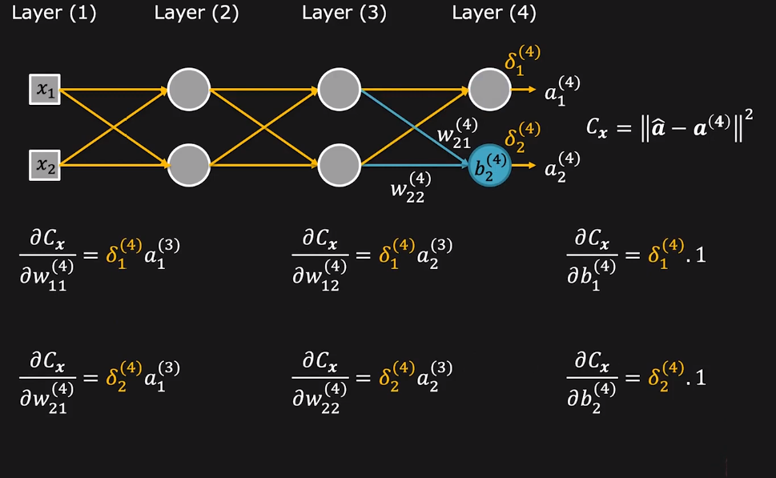
Computing Gradient using Chain Rule

Slide 36
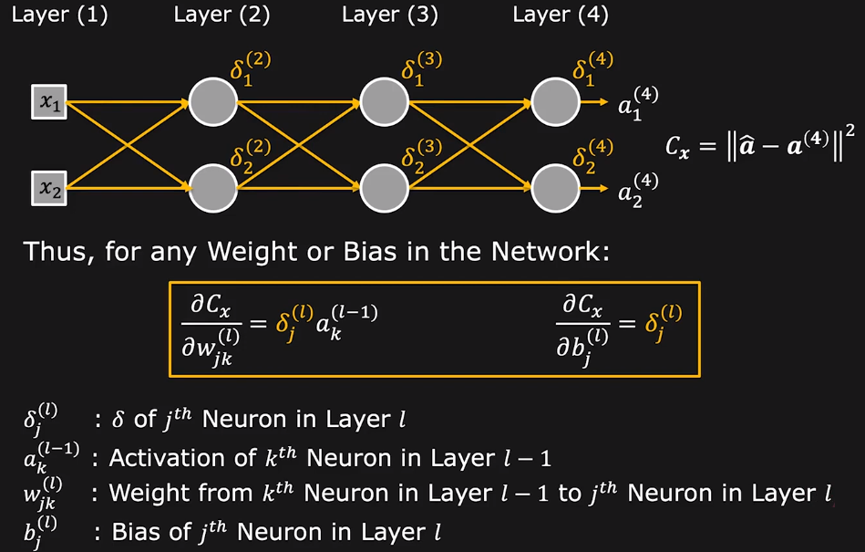
Computing Gradient using Chain Rule

Slide 37
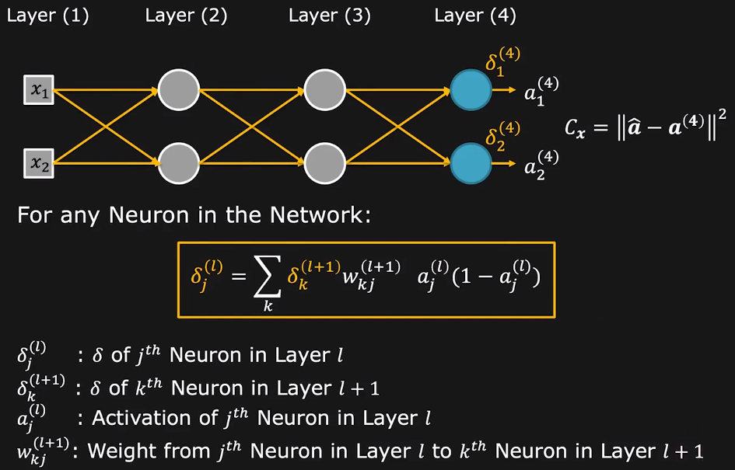
Backpropagation of δ

Slide 38
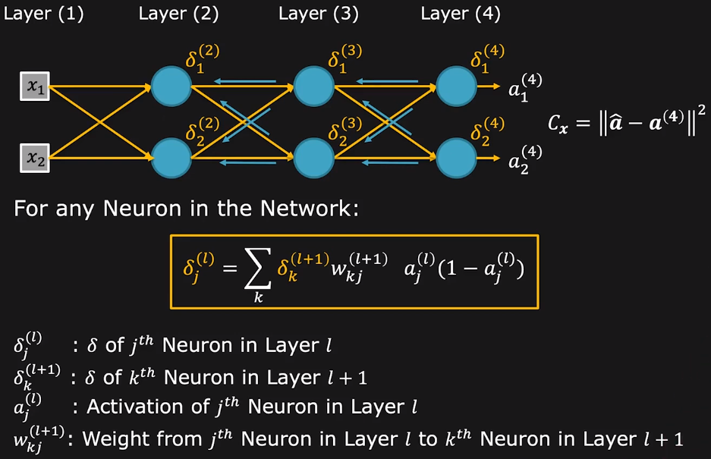
Backpropagation of δ

Slide 39
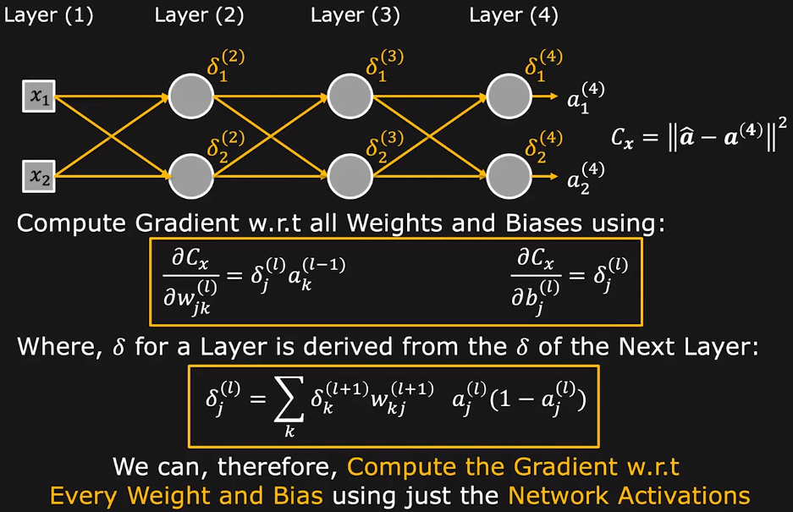
Backpropagation Algorithm

Slide 40
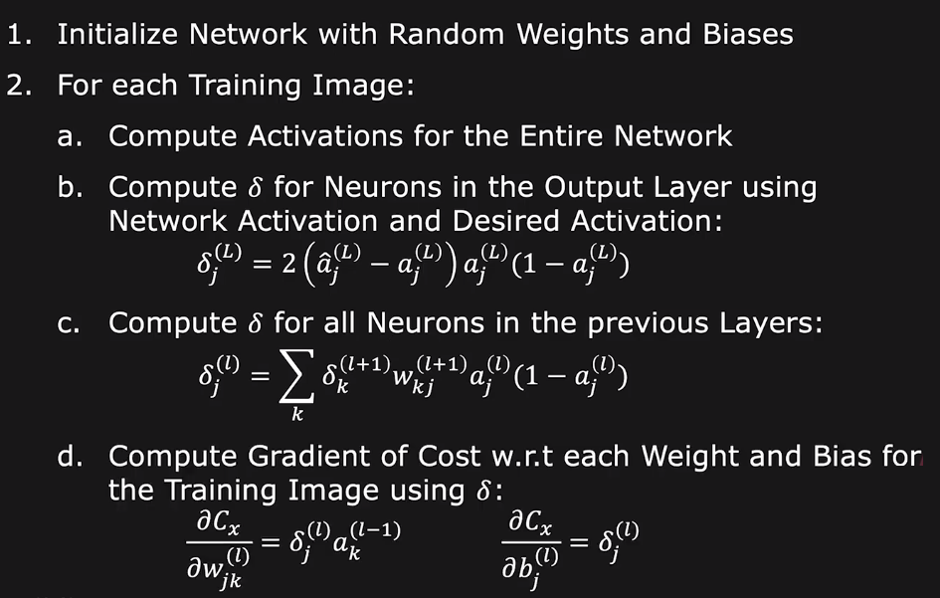
Gradient Descent with Backpropagation

Slide 41
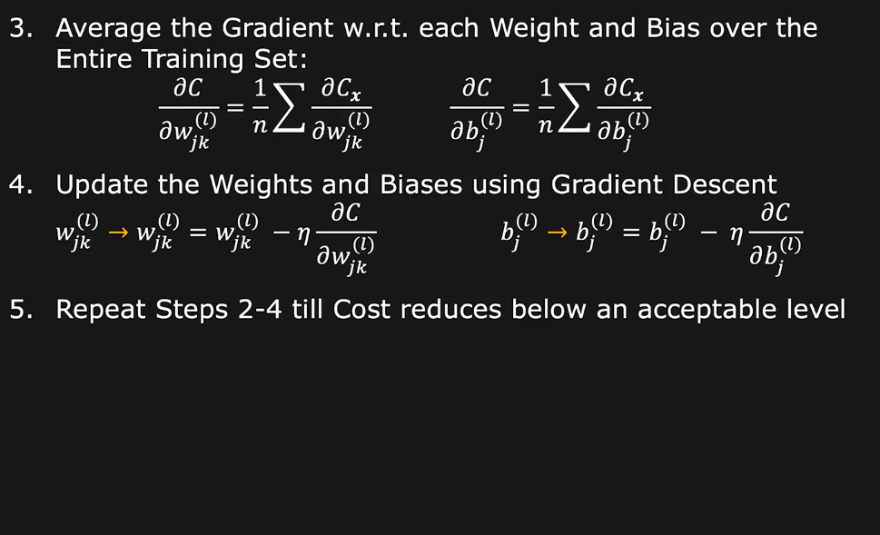
Gradient Descent with Backpropagation

Slide 42
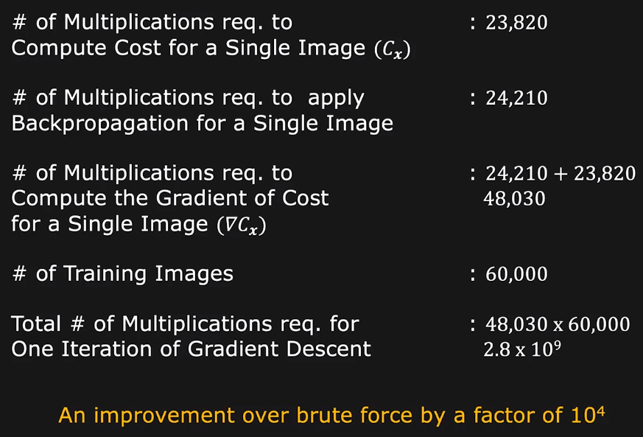
Gradient Computation Complexity

Slide 43
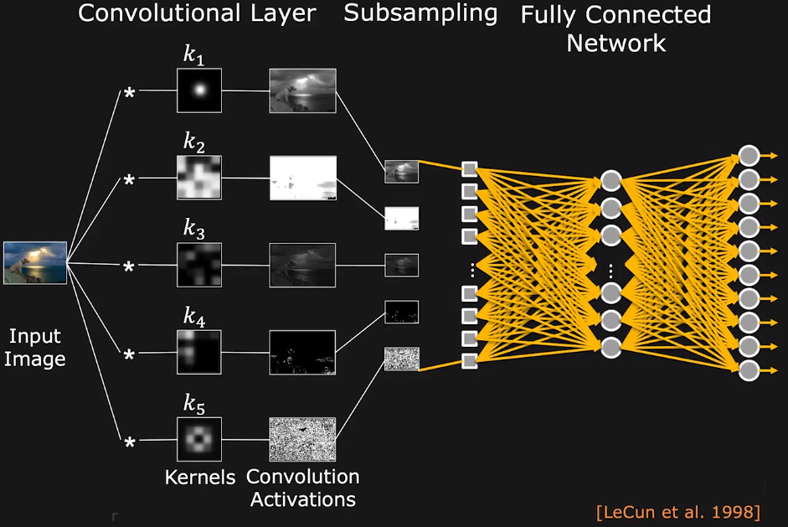
Convolution Neural Network (CNN)

Slide 44
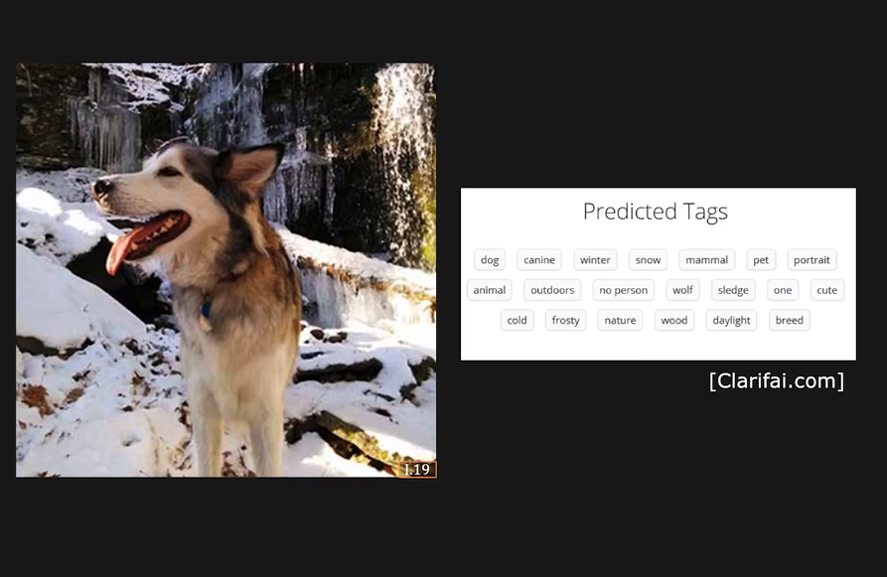
Application Examples: Autotagging

Slide 45
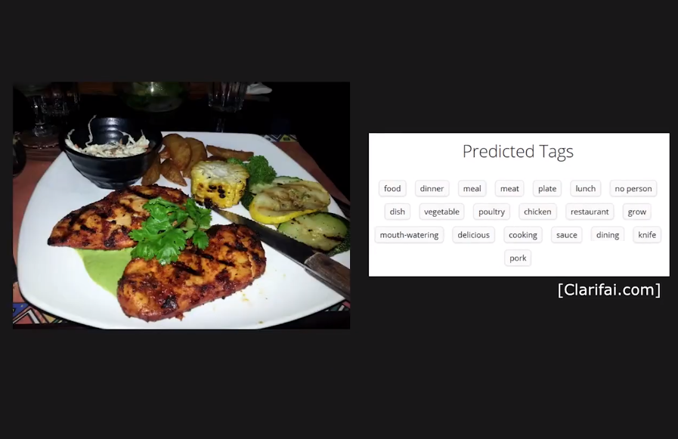
Application Examples: Autotagging

Slide 46
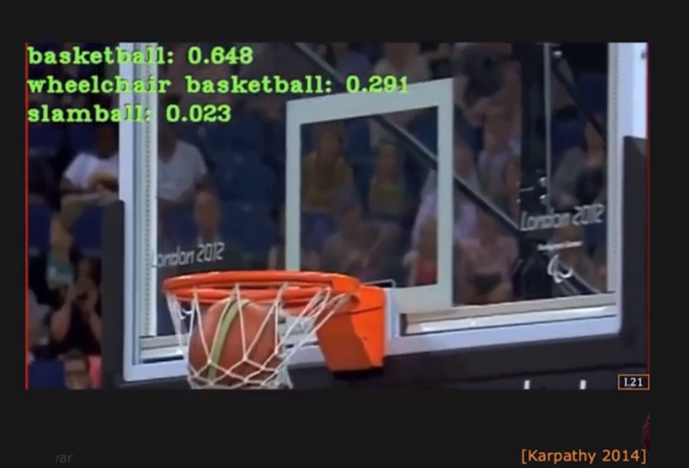
Application Examples: Video Classification

Slide 47
Thanks

